Slide 1


Hassan A. Baabdullah
Wednesday, January 20, 2024

Slide 2

Outline
Executive Summary
Introduction
Methodology
Results
Conclusion
Appendix

Slide 3
Executive Summary
Summary of Used Methodologies:
Using public information to predict if SpaceX will reuse the first stage.
Collecting data from SpaceX REST API and using this data to predict whether SpaceX will attempt to land a rocket or not.
Performing needed data wrangling to analyze and creating models.
Summary of Results:
Different launch sites have different success rates. As a result, they can be used to help determine if the first stage will land successfully.

Slide 4
Introduction
Project Background:
The commercial space age is here, with companies making space travel affordable for everyone. SpaceX leads the industry with accomplishments such as sending spacecraft to the International Space Station, launching Starlink satellite internet constellation, and conducting manned missions. SpaceX's cost-effective approach is due to reusable rocket launches, with Falcon 9 launches priced at $62 million, compared to other providers' $165 million. The first stage of Falcon 9 is critical and can be recovered, but its successful reuse is uncertain. As a data scientists for Space Y, our task is to gather information about SpaceX, create dashboards, and train a machine learning model to predict the reuse of the first stage.

Slide 5
Introduction
Problems we are going to solve:
Understand the technical issues that cause fail launches.
Determine the best launching sites and circumstances.
Determine the price of each launch.
Determine if SpaceX will reuse the first stage.
Instead of using rocket science to determine if the first stage will land successfully, we will train a machine learning model and use public information to predict if SpaceX will reuse the first stage..

Slide 6

Section 1

Slide 7
Methodology
Executive Summary
Data collection methodology:
Public information from List of "Falcon 9 and Falcon Heavy launches" (Wikipedia).
SpaceX REST API.
Perform data wrangling
We will convert the [Outcome] to be classified, 0 (did not land) and 1 (did land).
Perform exploratory data analysis (EDA) using visualization and SQL
Perform interactive visual analytics using Folium and Plotly Dash
Perform predictive analysis using classification models
Using 'Exploratory Data Analysis' and observing success rate results.
In addition, we will determine what attributes are correlated with successful landings.

Slide 8
Data Collection
We will use public information about Falcon 9 rocket, which is available on Wikipedia page (List of Falcon 9 and Falcon Heavy launches) at https://en.wikipedia.org/wiki/List_of_Falcon_9_and_Falcon_Heavy_launches .
Key Phrases:
Data Collection Source: SpaceX launch data gathered from the SpaceX REST API.
API Endpoint: The SpaceX REST API endpoints start with api.spacexdata.com/v4/ and include /capsules, /cores, and specifically /launches/past.
Data Transformation: JSON data from the API will be converted to a dataframe using the json_normalize function.
Data Sources: Web scraping of Wiki pages to obtain Falcon 9 launch data.

Slide 9
Data Collection (Continued..)
Key Phrases (Continued...):
Data Wrangling: Wrangling data using an API, sampling data, and dealing with null values.
Filtering Data: Filtering out Falcon 1 launches from the dataset.
Handling Null Values: Calculating the mean of PayloadMass data and replacing null values with the mean.
Data Quality: Dealing with NULL values in PayloadMass and leaving the column LandingPad with NULL values for one hot encoding.

Slide 10
Data Collection – SpaceX API
Data Collection Process: Gather data from the SpaceX REST API using the specific endpoint for past launches.
Data Transformation Process: Convert JSON data to a DataFrame using the json_normalize function.
Additional Data Source: Web scraping of Wiki pages to obtain Falcon 9 launch data.
Data Wrangling Process: Wrangling data using an API, sampling data, and handling null values.
Filtering Process: Filtering out Falcon 1 launches from the dataset.
Data Quality Check: Calculating the mean of PayloadMass data and replacing null values with the mean.
Data Encoding: Handling NULL values in LandingPad column using one hot encoding.
Public Data
Data Collection
Data Transformation
Data Wrangling
SpaceX REST API
Filtering
Encoding
Quality Check

Slide 11
Data Collection - Scraping
Web scraping process:
Using BeautifulSoup Library.
Extract a Falcon 9 launch records HTML table from Wikipedia
Parse the table and convert it into a Pandas data frame
GitHub Repository URL: python-applied-data-science-capstone/jupyter-labs-webscraping.ipynb at master · hsnapps/python-applied-data-science-capstone (github.com)
Using the Wikipedia Page "List of Falcon 9 and Falcon Heavy launches" at
https://en.wikipedia.org/w/index.php?title=List_of_Falcon_9_and_Falcon_Heavy_launches&oldid=1027686922
Request the URL
Extract column names
Extract column names from HTML table header
Create DataFrame
Create a data frame by parsing the launch HTML tables

Slide 12
Data Wrangling
Normalizing Data :
Calculating the number of launches on each site.
Calculating the number and occurrence of each orbit.
Calculating the number and occurence of mission outcome of the orbits.
Classification:
Creating a landing outcome label from Outcome column
GitHub Repository URL: python-applied-data-science-capstone/labs-jupyter-spacex-Data wrangling.ipynb at master · hsnapps/python-applied-data-science-capstone (github.com)
Normalizing Data
Calculating the number of launches on each site
Calculating the number and occurrence of each orbit
Calculating the number and occurence of mission outcome of the orbits
Classification
Creating a landing outcome label from Outcome column

Slide 13
EDA with Data Visualization
Plotted Charts:
Scatter chart to indicate the continuous launch attempts between FlightNumber and Payload.
Scatter chart to visualize the relationship between FlightNumber and LaunchSite.
Scatter chart to visualize the relationship between FlightNumber and PayloadMass.
Bar chart to visualize the relationship between success rate of each orbit type.
Scatter chart to visualize the relationship between FlightNumber and Orbit type.
Line chart to visualize the launch success yearly trend.
GitHub Repository URL:
python-applied-data-science-capstone/jupyter-labs-eda-dataviz.ipynb at master · hsnapps/python-applied-data-science-capstone (github.com)

Slide 14
EDA with SQL
SQL Queries:
Creating SPACEXTABLE table to remove blank rows from table: CREATE TABLE SPACEXTABLE AS SELECT * FROM SPACEXTBL WHERE "DATE" IS NOT NULL
Display the names of the unique launch sites in the space mission: SELECT DISTINCT "Launch_Site" FROM SPACEXTABLE
Display 5 records where launch sites begin with the string 'CCA': SELECT * FROM SPACEXTABLE WHERE Launch_Site LIKE 'CCA%' LIMIT 5
Display the total payload mass carried by boosters launched by NASA (CRS): SELECT SUM(PAYLOAD_MASS__KG_) AS SUM_PAYLOAD_MASS_NASA_CRS FROM SPACEXTABLE WHERE Customer = 'NASA (CRS)'
Display average payload mass carried by booster version F9 v1.1: SELECT AVG(PAYLOAD_MASS__KG_) AS AVG_F9_v1_1 FROM SPACEXTABLE WHERE Booster_Version = 'F9 v1.1'
List the date when the first successful landing outcome in ground pad was achieved: SELECT MIN("Date") AS FIRST_SUCCESS_GROUND FROM SPACEXTABLE WHERE Landing_Outcome = 'Success (ground pad)'

Slide 15
EDA with SQL
SQL Queries:
List the names of the boosters which have success in drone ship and have payload mass greater than 4000 but less than 6000: SELECT DISTINCT Booster_Version FROM SPACEXTABLE WHERE Landing_Outcome = 'Success (drone ship)' AND PAYLOAD_MASS__KG_ BETWEEN 4000 AND 6000
List the total number of successful and failure mission outcomes: SELECT Mission_Outcome, COUNT(*) AS "Count" FROM SPACEXTABLE GROUP BY Mission_Outcome
List the names of the booster_versions which have carried the maximum payload mass. Use a subquery: SELECT DISTINCT Booster_Version FROM SPACEXTABLE WHERE PAYLOAD_MASS__KG_ IN(SELECT MAX(PAYLOAD_MASS__KG_) FROM SPACEXTABLE)
List the records which will display the month names, failure landing_outcomes in drone ship ,booster versions, launch_site for the months in year 2015: SELECT SUBSTR("Date", 6, 2) AS 'Month', SUBSTR("Date", 0, 5) AS 'Year', Landing_Outcome FROM SPACEXTABLE WHERE Landing_Outcome LIKE 'Failure%' AND "Year" = '2015'

Slide 16
EDA with SQL
SQL Queries:
Rank the count of landing outcomes (such as Failure (drone ship) or Success (ground pad)) between the date 2010-06-04 and 2017-03-20, in descending order: SELECT Landing_Outcome, COUNT(*) AS cnt FROM SPACEXTABLE WHERE "Date" BETWEEN '2010-06-04' AND '2017-03-20' GROUP BY Landing_Outcome ORDER BY cnt DESC
GitHub Repository URL:
python-applied-data-science-capstone/jupyter-labs-eda-sql-coursera_sqllite.ipynb at master · hsnapps/python-applied-data-science-capstone (github.com)

Slide 17
Build an Interactive Map with Folium
Map Objects Used:
Markers (folium.map.Marker) on all launch sites: To show the locations of launch stations on a map.
Highlighting circles (folium.Circle): To highlight launch locations.
Markers on the success/failed launches for each site on the map: To distinguish the success/failure launch sites.
Distance lines (folium.PolyLine) between a launch site to its proximities: To display the distance between the launch site and the nearest milestones.
GitHub Repository URL:
python-applied-data-science-capstone/lab_jupyter_launch_site_location.ipynb at master · hsnapps/python-applied-data-science-capstone (github.com)

Slide 18
Build a Dashboard with Plotly Dash
Graphs and plots used in the Dashboard:
Pie chart interacts with dropdown component:
The dropdown contains the selection list of "ALL" followed by launching sites.
When the user selects "ALL" the pie charts displays the total attempts of each site.
When the user selects a site name the pie chart displays the success/failure attempts of the site.
Scatter chart displays the correlation between payload mass and launching attempts, interacts with range-slide component and dropdown component:
The user can specify the "Payload Range (Kg)" ranges from the range-slide.
If the dropdown value is "ALL", the chart displays correlation for all sites, otherwise it displays the correlation for the selects site.
GitHub Repository URL:
python-applied-data-science-capstone/spacex_dash_app.py at master · hsnapps/python-applied-data-science-capstone (github.com)

Slide 19
Predictive Analysis (Classification)
Normalize the data for X and Y by using python libraries such as NumPy and scikit-learn.
Split the training and testing samples using train_test_split from scikit-learn.
Creating a logistic regression and GridSearchCV to perform hyperparameter tuning then calculating the accuracy.
Creating SVM object and GridSearchCV object to find the best parameters from the dictionary parameters then calculating the accuracy.
Creating a decision tree classifier object and GridSearchCV object to to find the best parameters from the dictionary parameters then calculating the accuracy.
Create a KNN object and GridSearchCV object to find the best parameters from the dictionary parameters then calculating the accuracy.
Finding the method performs best

Slide 20
Results
Exploratory data analysis results:
Different launch sites have different success rates.
Success rate since 2013 has improved.
CCAFS LC-40 has a success rate of 60%, while KSC LC-39A and VAFB SLC 4E have a success rate of around 77%.
If the mass is above 10,000 kg the success rate of CCAFS LC-40 is 100%.
Predictive analysis results ( The best accuracy):
Model | Accuracy
Logistic Regression | 0.8464285714285713
Support Vector Machine | 0.8732142857142856
K-Nearest Neighbors | 0.8482142857142858
Decision Tree Accuracy  | 0.8482142857142856

Slide 21

Section 2

Slide 22
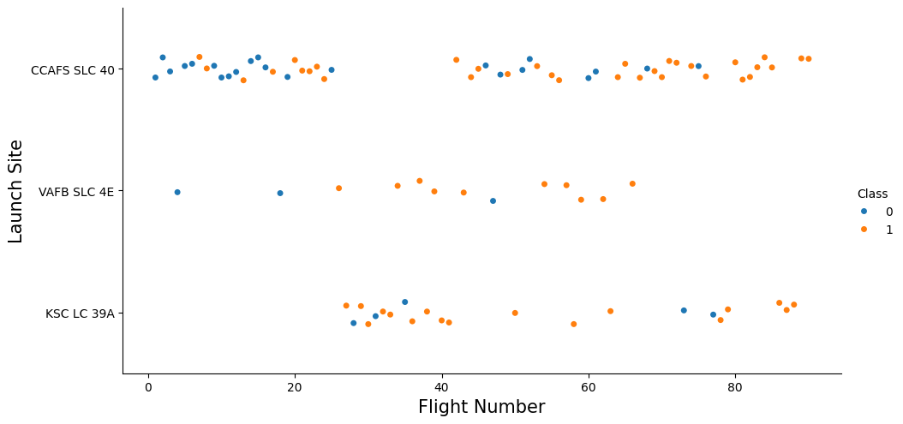
Flight Number vs. Launch Site
Success rate increases in the late flights.

Slide 23
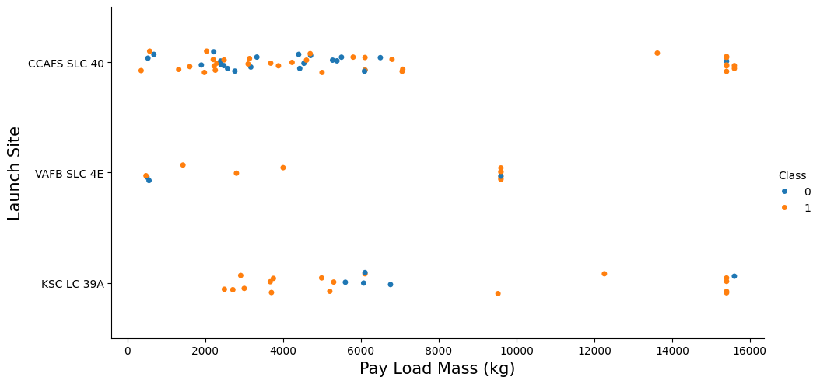
Payload vs. Launch Site
If the mass is above 10,000 kg the success rate of CCAFS LC-40 is 100%.

Slide 24
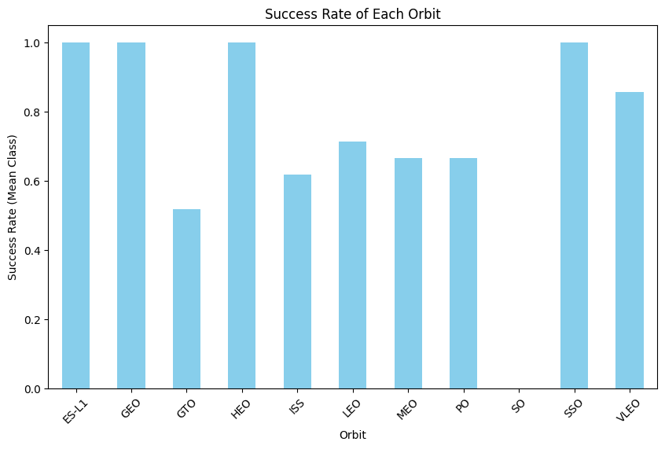
Success Rate vs. Orbit Type
Orbits ES-L1, GEO, HEO and SSO have the best success rate.

Slide 25
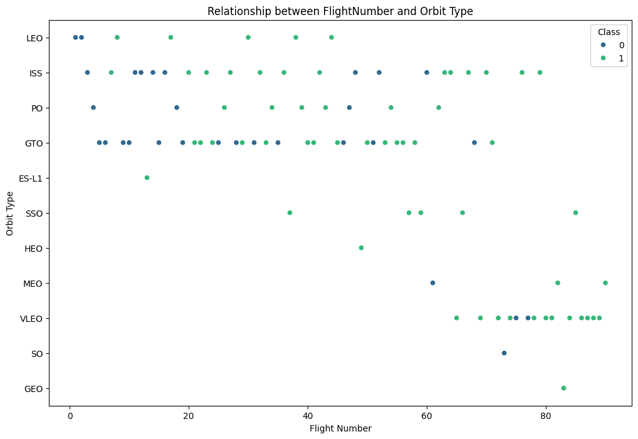
Flight Number vs. Orbit Type
The LEO orbit the Success appears related to the number of flights.
No clear relationship between flight number when in GTO orbit.

Slide 26
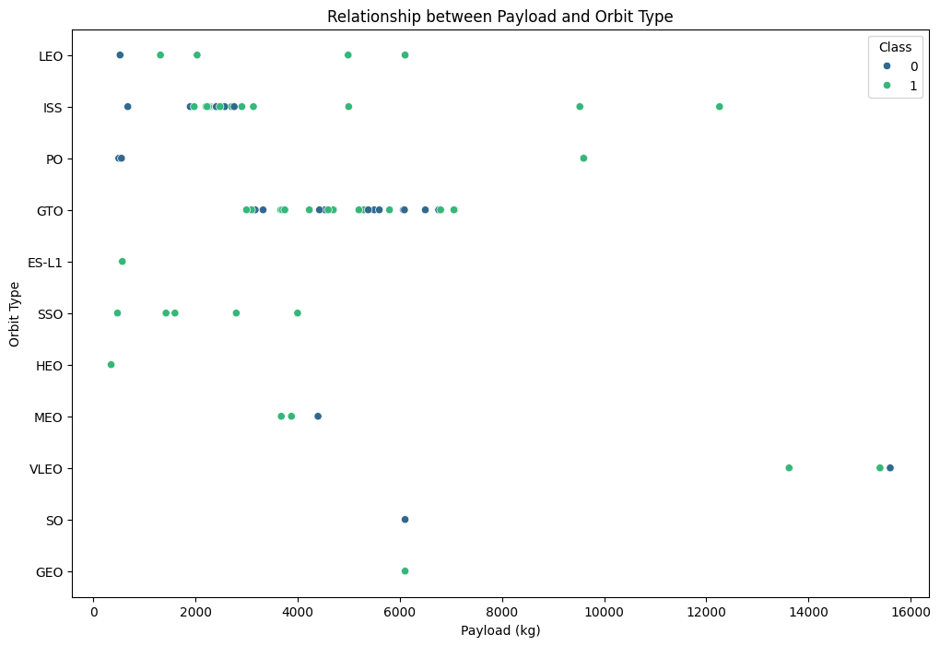
Payload vs. Orbit Type
With heavy payloads the successful landing or positive landing rate are more for Polar,LEO and ISS.
We cannot distinguish this well as both positive landing rate and negative landing(unsuccessful mission) are both there here.

Slide 27
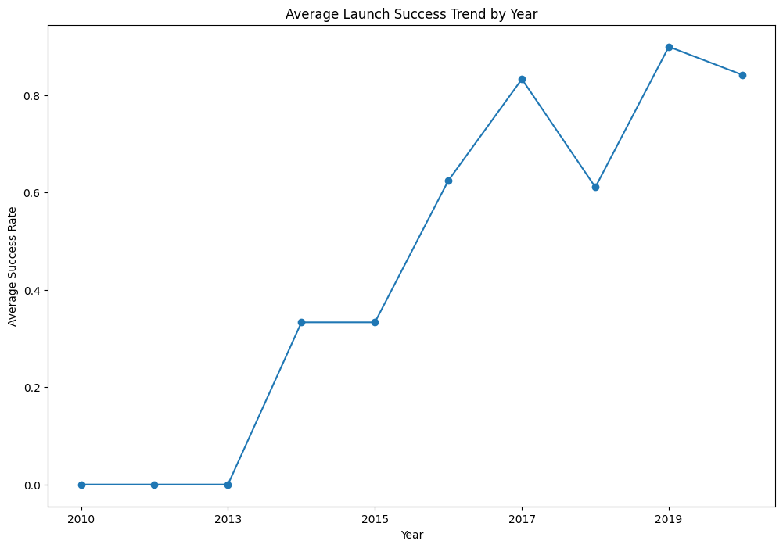
Launch Success Yearly Trend
The success rate since 2013 kept increasing till 2017 (stable in 2014) and after 2015 it started increasing.

Slide 28
All Launch Site Names
Query
SELECT DISTINCT Launch_Site FROM SPACEXTABLE
Result
Launch_Site
CCAFS LC-40
VAFB SLC-4E
KSC LC-39A
CCAFS SLC-40
Explanation
Displays the names of the unique launch sites in the space mission

Slide 29
Launch Site Names Begin with 'CCA'
Query
SELECT * FROM SPACEXTABLE WHERE Launch_Site LIKE 'CCA%' LIMIT 5
Result
Date | Time (UTC) | Booster_Version | Launch_Site | Payload | PAYLOAD_MASS__KG_ | Orbit | Customer | Mission_Outcome | Landing_Outcome
2010-06-04 | 18:45:00 | F9 v1.0 B0003 | CCAFS LC-40 | Dragon Spacecraft Qualification Unit | 0 | LEO | SpaceX | Success | Failure (parachute)
2010-12-08 | 15:43:00 | F9 v1.0 B0004 | CCAFS LC-40 | Dragon demo flight C1, two CubeSats, barrel of Brouere cheese | 0 | LEO (ISS) | NASA (COTS) NRO | Success | Failure (parachute)
2012-05-22 | 7:44:00 | F9 v1.0 B0005 | CCAFS LC-40 | Dragon demo flight C2 | 525 | LEO (ISS) | NASA (COTS) | Success | No attempt
2012-10-08 | 0:35:00 | F9 v1.0 B0006 | CCAFS LC-40 | SpaceX CRS-1 | 500 | LEO (ISS) | NASA (CRS) | Success | No attempt
2013-03-01 | 15:10:00 | F9 v1.0 B0007 | CCAFS LC-40 | SpaceX CRS-2 | 677 | LEO (ISS) | NASA (CRS) | Success | No attempt
Explanation
Displays 5 records where launch sites begin with the string 'CCA'

Slide 30
Total Payload Mass
Query
SELECT SUM(PAYLOAD_MASS__KG_) AS SUM_PAYLOAD_MASS_NASA_CRS FROM SPACEXTABLE WHERE Customer = 'NASA (CRS)'
Result
SUM_PAYLOAD_MASS_NASA_CRS
45596
Explanation
Displays the total payload mass carried by boosters launched by NASA (CRS)

Slide 31
Average Payload Mass by F9 v1.1
Query
SELECT AVG(PAYLOAD_MASS__KG_) AS AVG_F9_v1_1 FROM SPACEXTABLE WHERE Booster_Version = 'F9 v1.1'
Result
AVG_F9_v1_1
2928.4
Explanation
Displays average payload mass carried by booster version F9 v1.1

Slide 32
First Successful Ground Landing Date
Query
SELECT MIN("Date") AS FIRST_SUCCESS_GROUND FROM SPACEXTABLE WHERE Landing_Outcome = 'Success (ground pad)'
Result
FIRST_SUCCESS_GROUND
2015-12-22
Explanation
Lists the date when the first successful landing outcome in ground pad was acheived.

Slide 33
Successful Drone Ship Landing with Payload between 4000 and 6000
Query
SELECT DISTINCT Booster_Version FROM SPACEXTABLE WHERE Landing_Outcome = 'Success (drone ship)' AND PAYLOAD_MASS__KG_ BETWEEN 4000 AND 6000
Result
Booster_Version
F9 FT B1022
F9 FT B1026
F9 FT B1021.2
F9 FT B1031.2
Explanation
Lists the names of the boosters which have success in drone ship and have payload mass greater than 4000 but less than 6000.

Slide 34
Total Number of Successful and Failure Mission Outcomes
Query
SELECT Mission_Outcome, COUNT(*) AS "Count" FROM SPACEXTABLE GROUP BY Mission_Outcome
Result
Mission_Outcome | Count
Failure (in flight) | 1
Success | 98
Success | 1
Success (payload status unclear) | 1
Explanation
Lists the total number of successful and failure mission outcomes.

Slide 35
Boosters Carried Maximum Payload
Query
SELECT DISTINCT Booster_Version FROM SPACEXTABLE WHERE PAYLOAD_MASS__KG_ IN(SELECT MAX(PAYLOAD_MASS__KG_) FROM SPACEXTABLE)
Result
Booster_Version
F9 B5 B1048.4
F9 B5 B1049.4
F9 B5 B1051.3
F9 B5 B1056.4
F9 B5 B1048.5
F9 B5 B1051.4
F9 B5 B1049.5
F9 B5 B1060.2
F9 B5 B1058.3
F9 B5 B1051.6
F9 B5 B1060.3
F9 B5 B1049.7
Explanation
Lists the names of the booster_versions which have carried the maximum payload mass. Use a subquery.

Slide 36
2015 Launch Records
Query
SELECT SUBSTR("Date", 6, 2) AS 'Month', SUBSTR("Date", 0, 5) AS 'Year', Landing_Outcome FROM SPACEXTABLE WHERE Landing_Outcome LIKE 'Failure%' AND "Year" = '2015'
Result
Month | Year | Landing_Outcome
01 | 2015 | Failure (drone ship)
04 | 2015 | Failure (drone ship)
Explanation
Lists the records which will display the month names, failure landing_outcomes in drone ship ,booster versions, launch_site for the months in year 2015.

Slide 37
Rank Landing Outcomes Between 2010-06-04 and 2017-03-20
Query
SELECT Landing_Outcome, COUNT(*) AS cnt FROM SPACEXTABLE WHERE "Date" BETWEEN '2010-06-04' AND '2017-03-20' GROUP BY Landing_Outcome ORDER BY cnt DESC
Result
Landing_Outcome | Count
No attempt | 10
Success (drone ship) | 5
Failure (drone ship) | 5
Success (ground pad) | 3
Controlled (ocean) | 3
Uncontrolled (ocean) | 2
Failure (parachute) | 2
Precluded (drone ship) | 1
Explanation
Ranking the count of landing outcomes (such as Failure (drone ship) or Success (ground pad)) between the date 2010-06-04 and 2017-03-20, in descending order.

Slide 38

Section 3

Slide 39
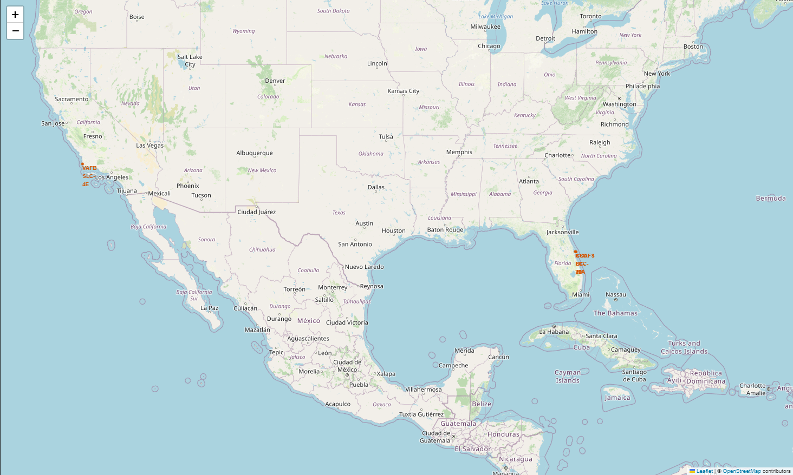
Launch Sites Location
In this map we can locate launch sites.
We notice that all sites are close to the coasts.
All the sites located between the latitudes 28 and 35, so they are not so close to the equator.

Slide 40
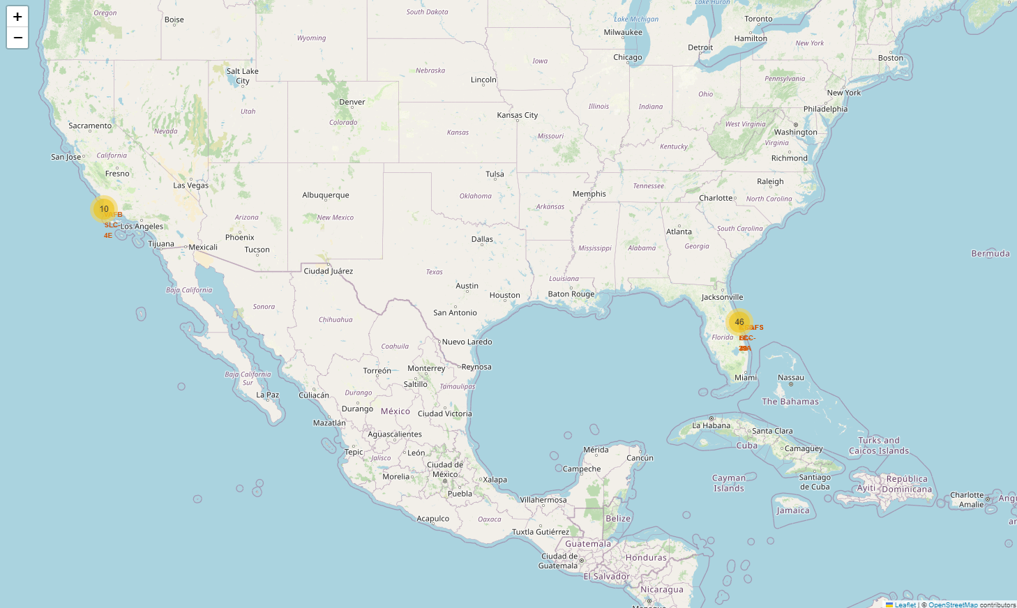
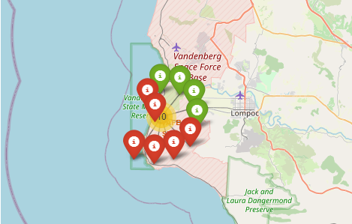
Success/Failed Launches For Each Site On The Map
In this interactive map we can see the locations of launch sites clickable and displays the Success/Failed launches of each site.

Slide 41
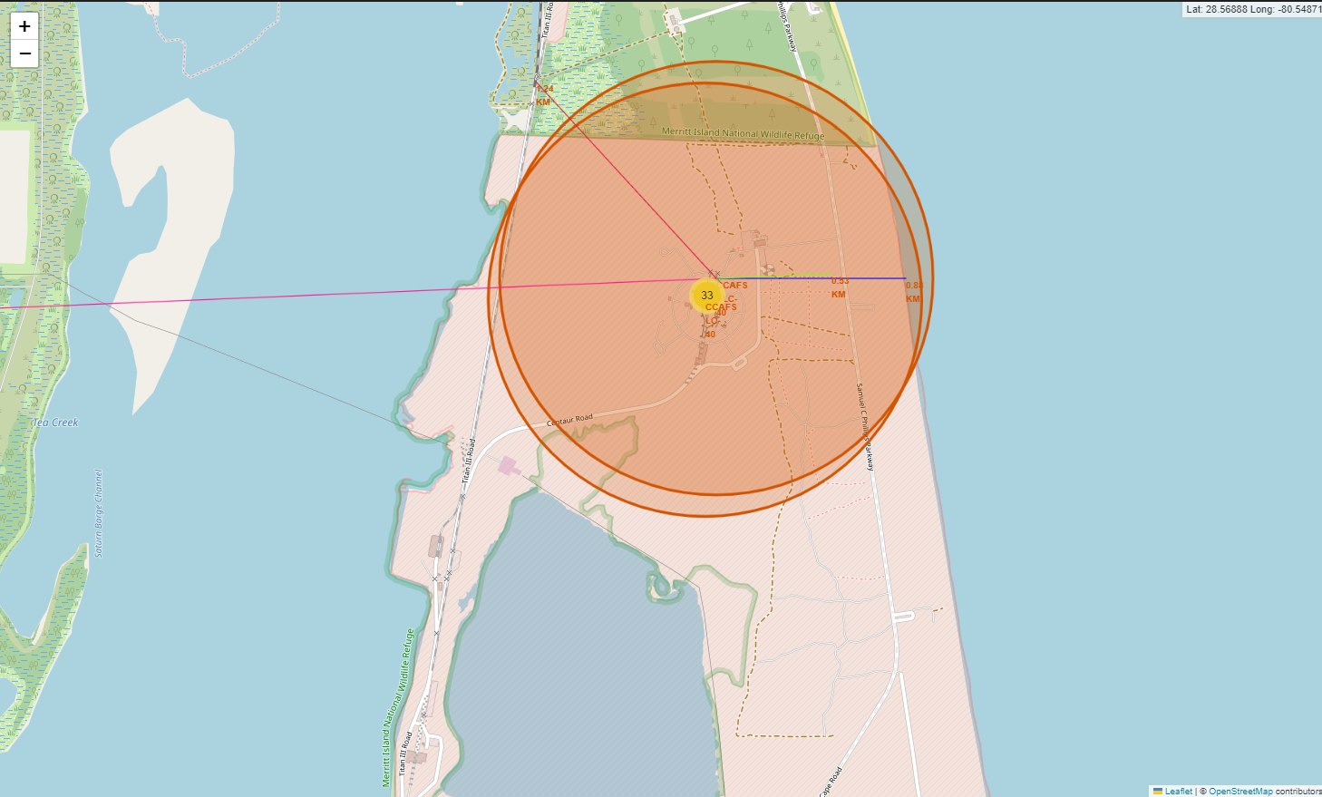
Distances Between A Launch Site And Proximities
In this map we can see the distance between a sample launch site (CCAFS SLC-40) and some proximities.
Although the site is quite close to coastline and railway, however, the distance between it and the nearest city is considered appropriate.

Slide 42

Section 4

Slide 43
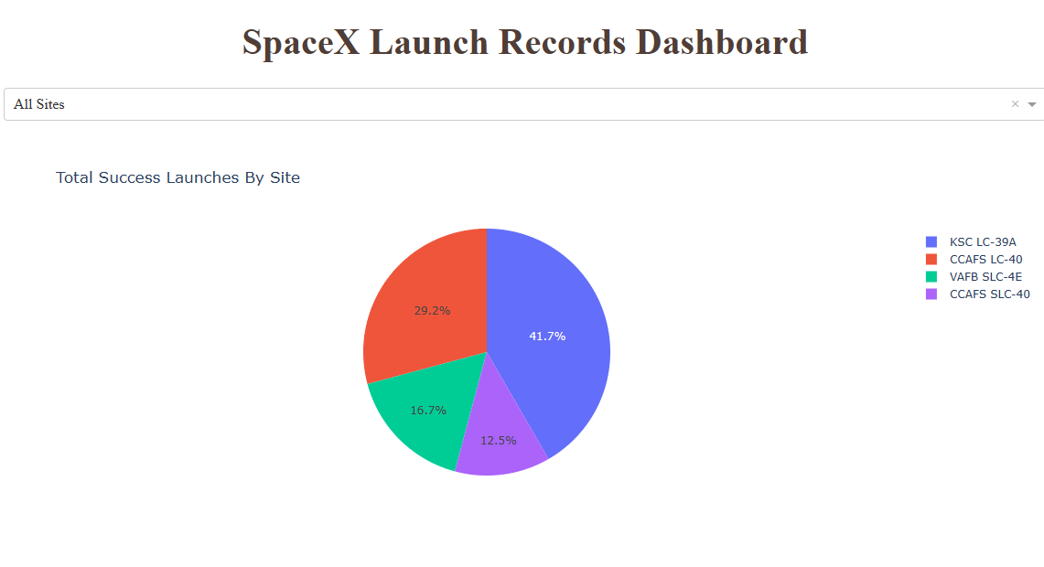
Launch Sites Interactive Dashboard
In the interactive dashboard, we can see a Pie chart displays total launches of each site.
The chart legend displays site’s name and its color on the chart.
The dropdown above the pie chart can be used to select a specific launch site, then the chart changes to display the success launces of the site.

Slide 44
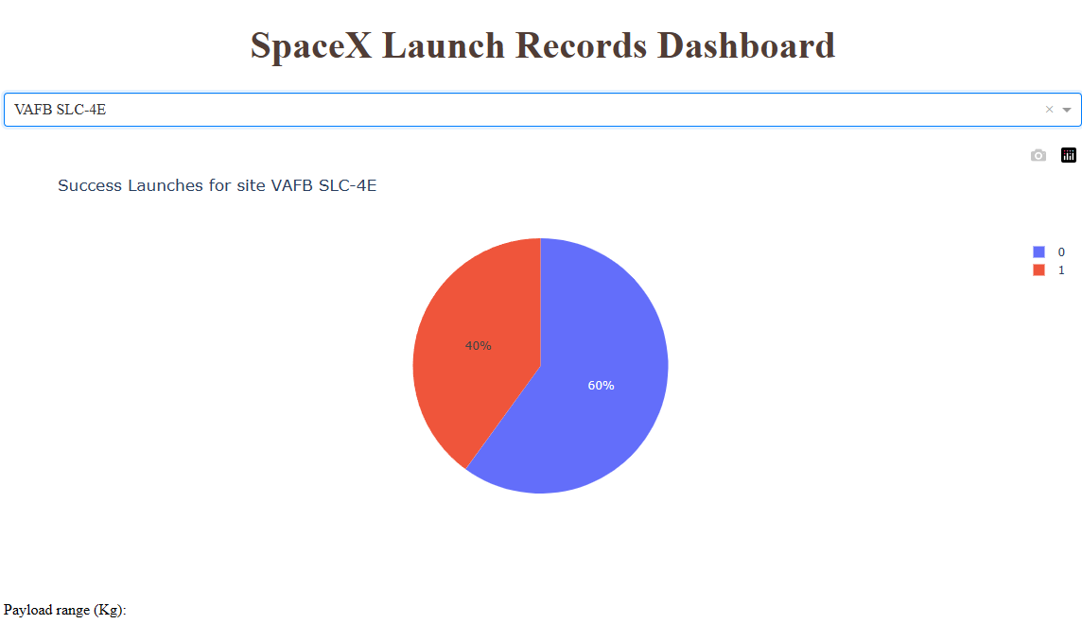
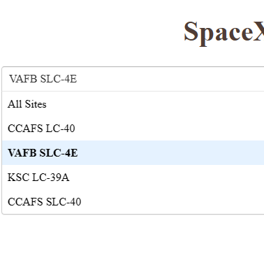
Launch Sites Interactive Dashboard
As seen on the screenshot, when we select a specific launch site the chart display the success launces of the site.

Slide 45
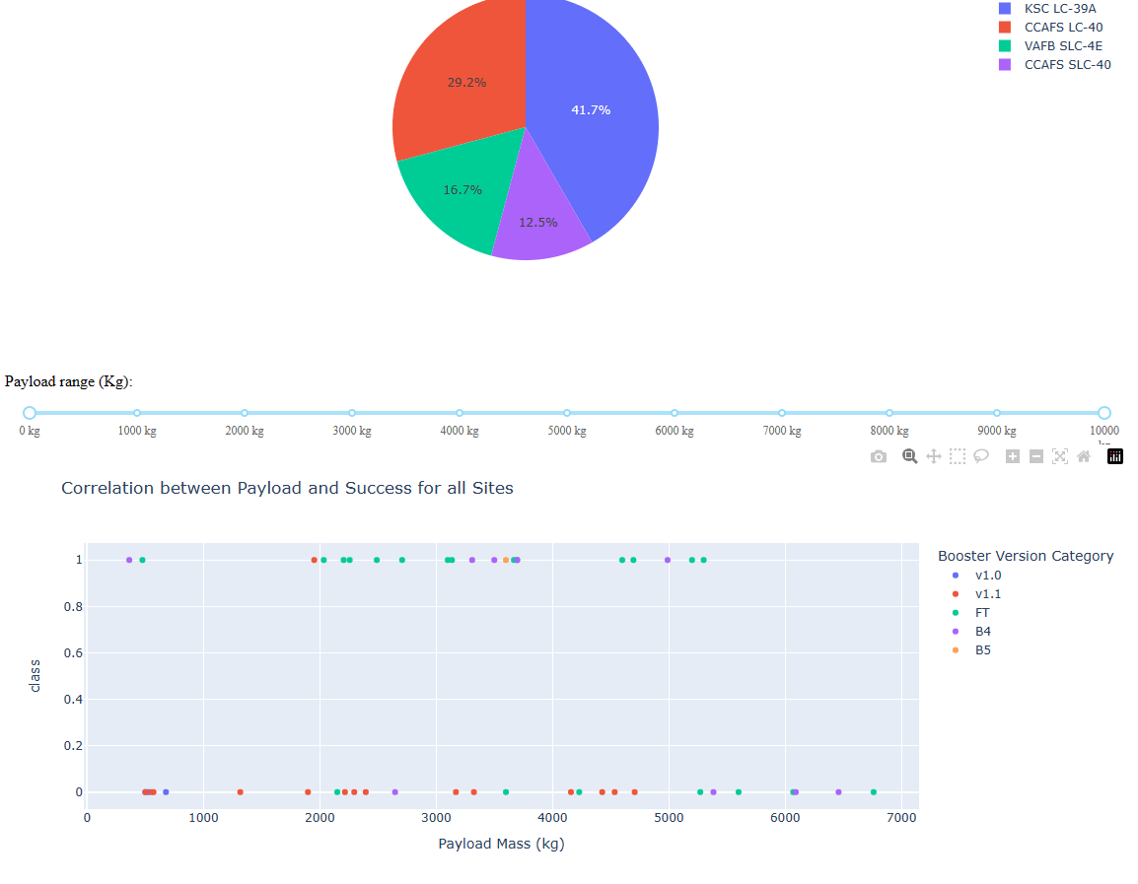
Launch Sites Interactive Dashboard
Below the pie chart, we can see a scatter chart that interacts with the above dropdown and a range-slide component represents the payload range in kilogram.

Slide 46

Section 5

Slide 47
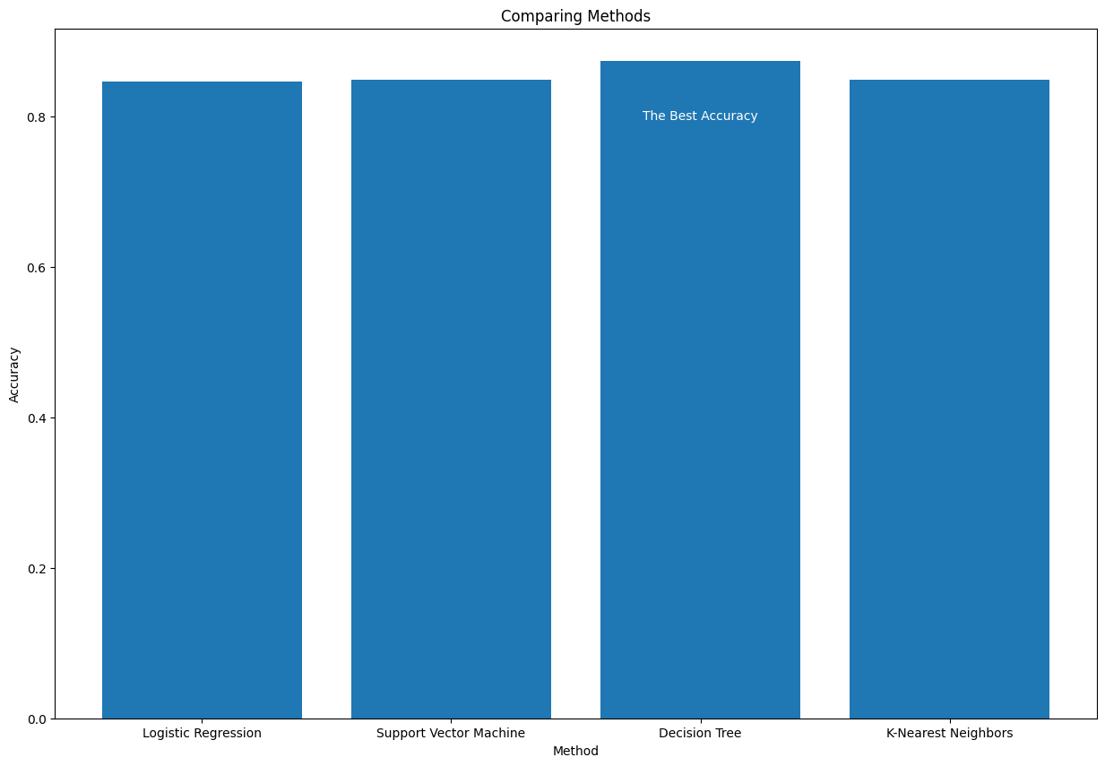
Classification Accuracy

Slide 48

Confusion Matrix
The Confusion Matrix of the models Logistic Regression, Support Vector Machine (SVM) and K-Nearest Neighbors (KNN).
The figure shows similarity of accuracy for the three models.

Slide 49
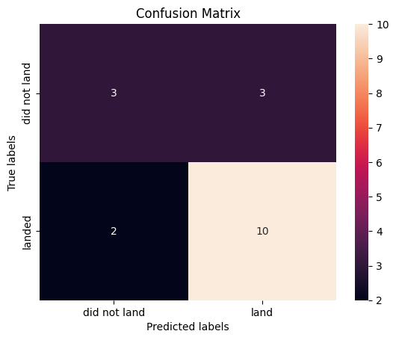
Confusion Matrix
The Confusion Matrix of the Decision Tree model.
The Decision Tree models gives us the best accuracy in prediction.

Slide 50
Conclusions
At the end of this study, we can say that the price of launch is predictable.
The most important parameters to predict are Payload Mass , Orbit and Launch Site.
The Tree Decision model is the best to use for predicting the price of launch with accuracy % 84.82.
There is a positive correlation between the payload mass and the success rate.
The best orbits for the rocket are: SSO, VLEO, HEO, GEO and LEO.

Slide 51
Appendix
Datasets used in the project:
SpaceX public API: https://api.spacexdata.com/v4/
List of Falcon 9 and Falcon Heavy launches on Wikipedia: https://en.wikipedia.org/wiki/List_of_Falcon_9_and_Falcon_Heavy_launches
Project repository on github.com: https://github.com/hsnapps/python-applied-data-science-capstone

Slide 52


